Slide 1
Entity-Relationship Model
E/R Diagrams
Weak Entity Set弱实体集合
Converting E/R Diagrams to Relations

Slide 2
Purpose of E/R Model
The E/R model allows us to sketch database schema designs.简述模式设计
Includes some constraints约束, but not operations.操作
Designs are pictures called entity relationship diagrams.
Later: convert E/R designs to relational DB designs.

Slide 3
Framework for E/R
Design is a serious business.
The “boss” knows they want a database, but they don’t know what they want in it.
Sketching the key components is an efficient way to develop a working database.

Slide 4
Entity Sets
1.Entity= “thing” or object.
2.Entityset= collection of similar entities.
Similar to a class in object-oriented languages.
3.Attribute= property of (the entities of) an entity set.
Attributes are simple values, e.g. integers or character strings, not structs, sets, etc.

Slide 5
E/R Diagrams
In an entity-relationship diagram:
Entity set = rectangle.
Attribute = oval, with a line to the rectangle representing its entity set.

Slide 6
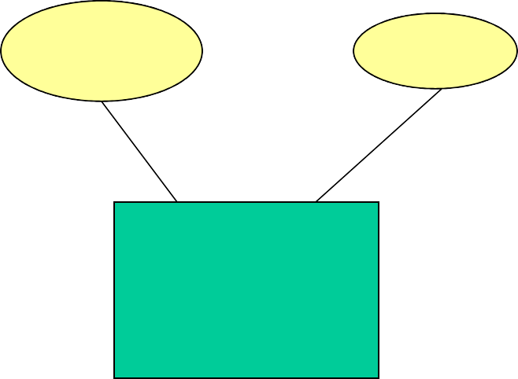
Example:
name
manf
Beers
Entity set Beers has two attributes, name and manf (manufacturer).
Each Beers entity has values for these two attributes, e.g. (Bud, Anheuser-Busch)

Slide 7
Relationships
A relationship connects two or more entity sets.
It is represented by a diamond, with lines to each of the entity sets involved.

Slide 8
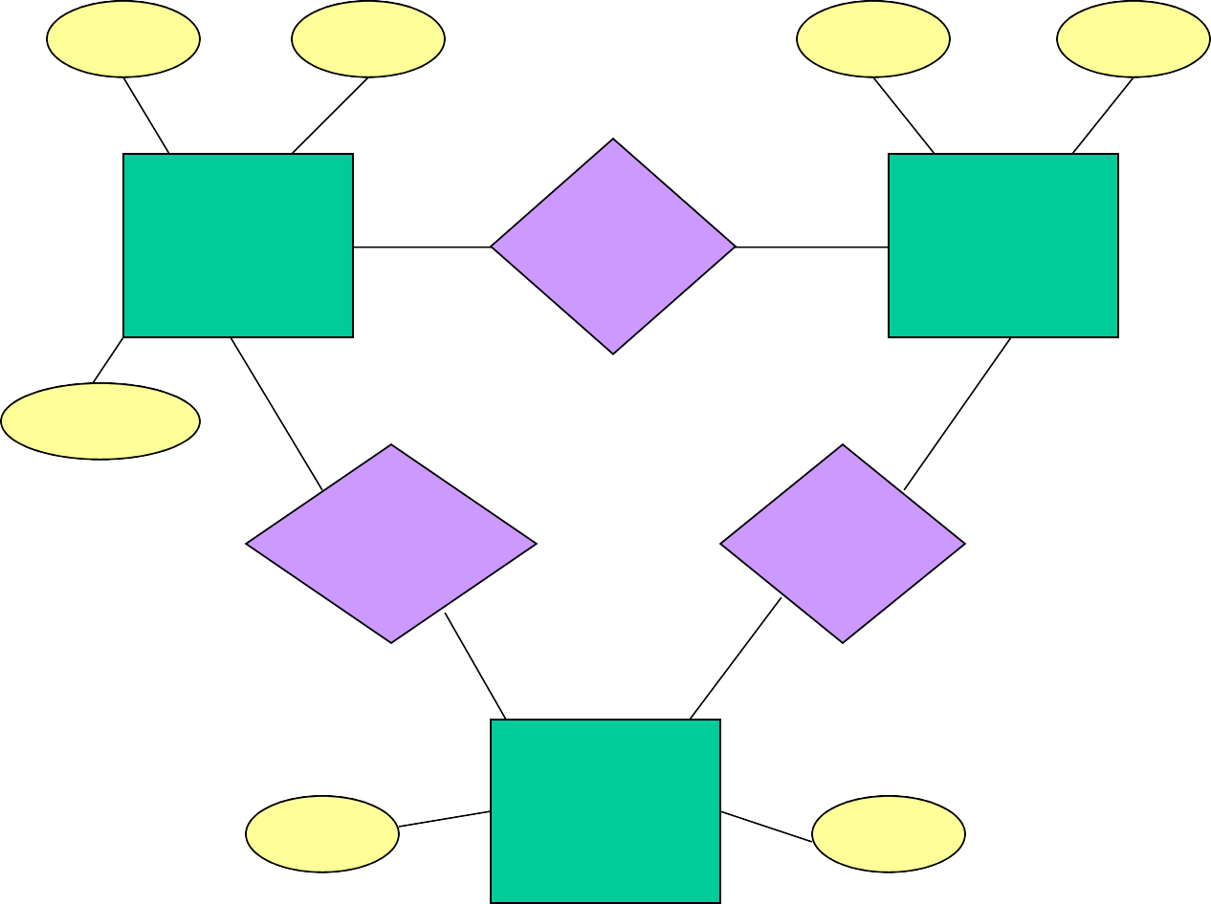
Example: Relationships
name
addr name manf
Bars
Sells
Beers
Bars sell some beers.
license
Drinkers like some beers.
Frequents
Likes
Note: license = beer, full, none
Drinkers frequent some bars.
name
Drinkers
addr

Slide 9
Relationship Set
The current “value” of an entity set is the set of entities that belong to it.
Example: the set of all bars in our database.
The “value” of a relationship is a relationshipset, a set of tuples with one component for each related entity set.

Slide 10
Example: Relationship Set
For the relationship Sells, we might have a relationship set like:
Bar Beer
Joe’s Bar Bud
Joe’s Bar Sue’s Bar Sue’s Bar Sue’s Bar
Miller Bud Pete’s Ale Bud Lite

Slide 11
Multiway多路Relationships
Sometimes, we need a relationship that connects more than two entity sets.
Suppose that drinkers will only drink certain beers at certain bars.
Our three binary relationships Likes, Sells, and Frequents do not allow us to make this distinction.
But a 3-way relationship would.

Slide 12
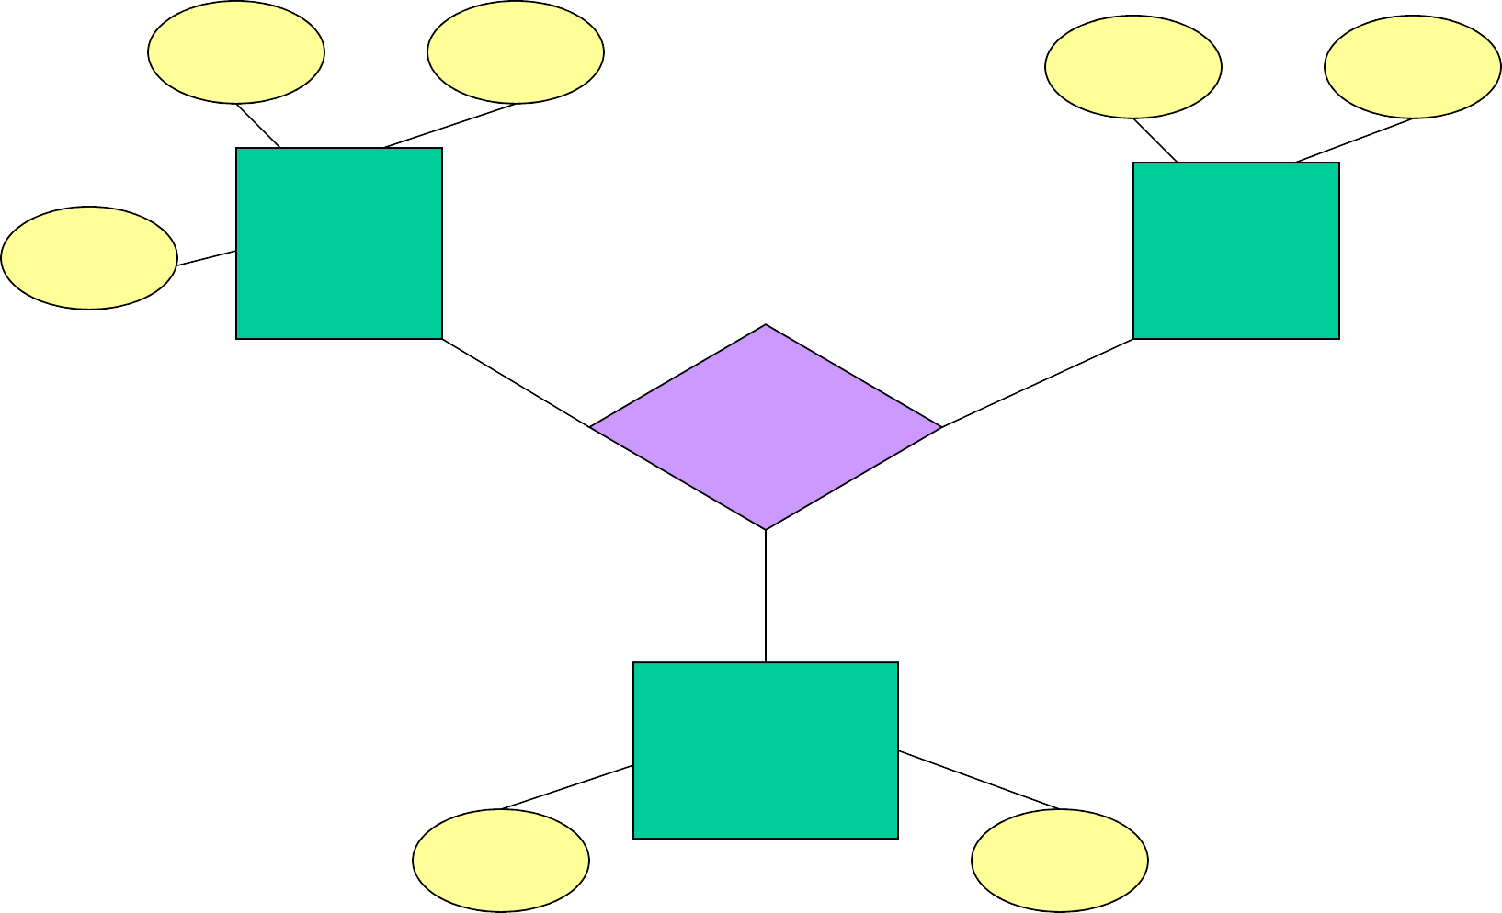
Example: 3-Way Relationship
name addr
name manf
license
Bars
Beers
Preferences
Drinkers
name
addr

Slide 13
A Typical Relationship Set
Bar | Drinker | Beer
Joe’s Bar | Ann | Miller
Sue’s Bar | Ann | Bud
Sue’s Bar | Ann | Pete’s Ale
Joe’s Bar | Bob | Bud
Joe’s Bar | Bob | Miller
Joe’s Bar | Cal | Miller
Sue’s Bar | Cal | Bud Lite

Slide 14
Many-Many Relationships
Focus: binary relationships, such as Sells between Bars and Beers.
In a many-many relationship多对多关系, an entity of either set can be connected to many entities of the other set.
E.g., a bar sells many beers; a beer is sold by many bars.

Slide 15
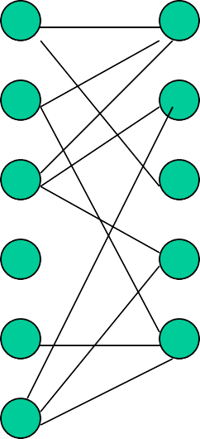
In Pictures:
many-many

Slide 16
Many-One Relationships
Some binary relationships are many-one from one entity set to another.
Each entity of the first set is connected to at most one entity of the second set.
But an entity of the second set can be connected to zero, one, or many entities of the first set.

Slide 17
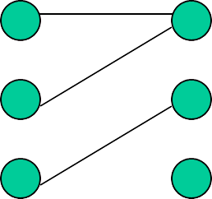
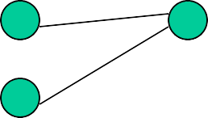

In Pictures:
many-one

Slide 18
Example: Many-One Relationship
Favorite, from Drinkers to Beers is many-one.
A drinker has at mo st one favorite beer.
But a beer can be the favorite of any number of drinkers, including zero.

Slide 19
One-One Relationships
In a one-onerelationship, each entity of either entity set is related to at most one entity of the other set..
Example: Relationship Best-seller between entity sets Manfs (manufacturer) and Beers.
A beer cannot be made by more than one manufacturer, and no manufacturer can have more than one best-seller (assume no ties).

Slide 20

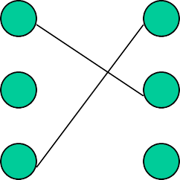
In Pictures:
one-one

Slide 21
Representing “Multiplicity”
Show a many-one relationship by an arrow entering the “one” side.
Remember: Like a functional dependency.
Show a one-one relationship by arrows entering both entity sets.
Rounded arrow = “exactly one,” i.e., each entity of the first set is related to exactly one entity of the target set.

Slide 22
Example: Many-One Relationship
Drinkers
Likes
Beers
Notice: two relationships connect the same entity sets, but are different.
Favorite

Slide 23
Example: One-One Relationship
Consider Best-seller between Manfs and Beers.
Some beers are not the best-seller of any manufacturer, so a rounded arrow to Manfs would be inappropriate.
But a beer manufacturer has to have a best-seller.

Slide 24
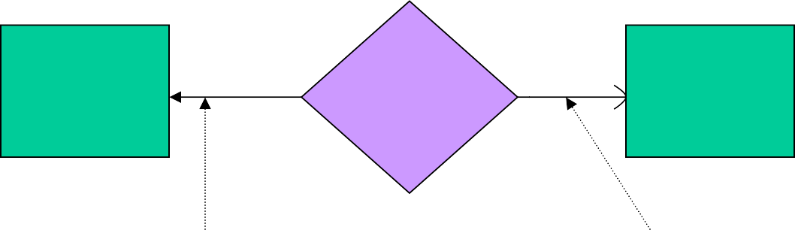
In the E/R Diagram
Best- seller
Manfs
Beers
A beer is the best- seller for 0 or 1 manufacturer.
A manufacturer has exactly one best seller.

Slide 25
Attributes on Relationships
Sometimes it is useful to attach an attribute to a relationship.
Think of this attribute as a property of tuples in the relationship set.

Slide 26
Example: Attribute on Relationship
Bars
Sells
Beers
price
Price is a function of both the bar and the beer, not of one alone.

Slide 27
Equivalent Diagrams 等价图Without Attributes on Relationships
Create an entity set representing values of the attribute.
Make that entity set participate in the relationship.

Slide 28
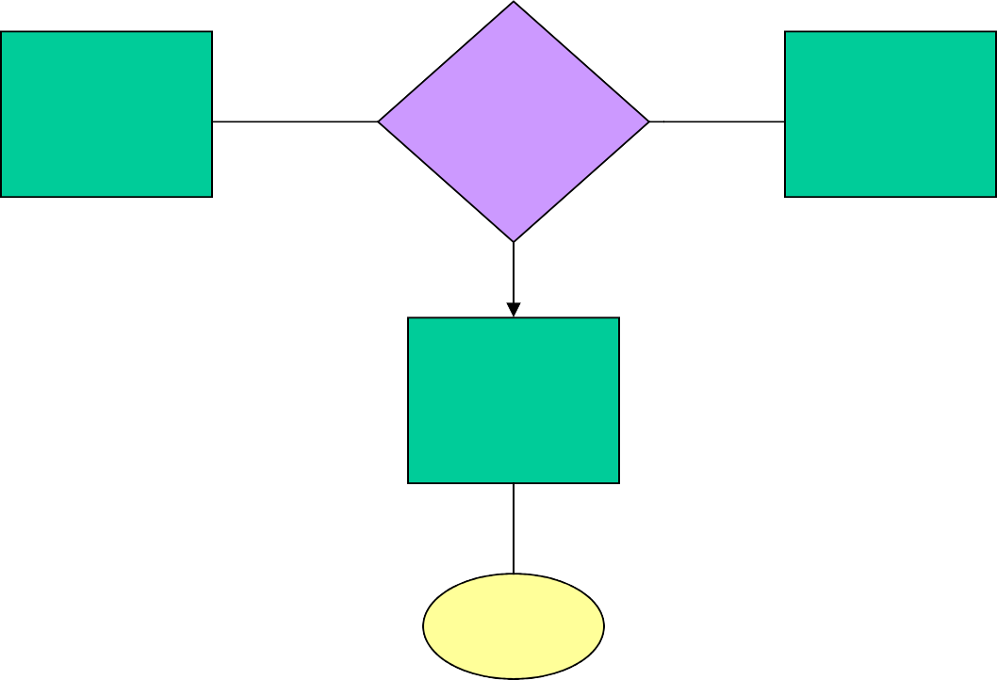
Example: Removing an Attribute from a Relationship
Bars
Sells
Beers
Note convention约定: arrow from multiway relationship
= “all other entity sets together determine a unique one of these.”
Prices
price

Slide 29
Roles
Sometimes an entity set appears more than once in a relationship.
Label the edges between the relationship and the entity set with names called roles.

Slide 30
Example: Roles
Relationship Set
Husband Wife
Bob Ann
Joe
…
Sue
…
Married
husband
wife
Drinkers

Slide 31
Example: Roles
Relationship Set
Buddy1 Bob
Buddy2 Ann
Joe Ann Joe
…
Sue Bob Moe
…
Buddies
1
2
Drinkers

Slide 32
Subclasses
Subclass= special case = fewer entities
= more properties.
Example: Ales are a kind of beer.
Not every beer is an ale, but some are.
Let us suppose that in addition to all the properties(attributes and relationships) of beers, ales also have the attribute color.

Slide 33
Subclasses in E/R Diagrams
Assume subclasses form a tree.
I.e., no multiple inheritance.
Isa triangles indicate 表示the subclass relationship.
Point to the superclass.

Slide 34
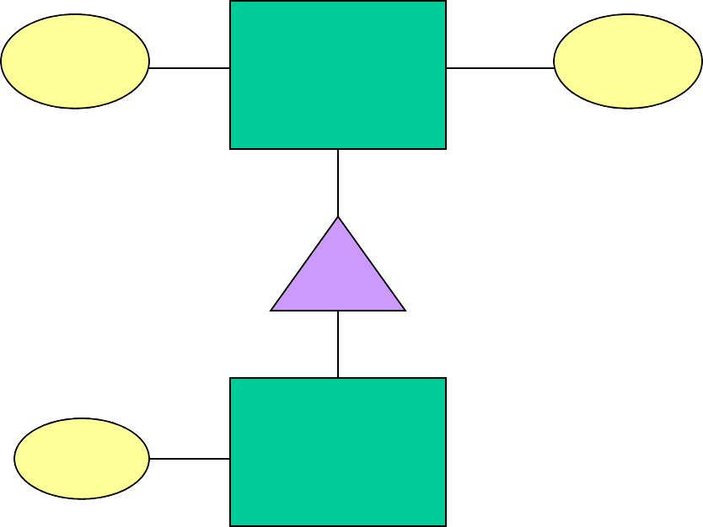

Example: Subclasses
name
Beers
manf
isa
color
Ales

Slide 35
E/R Vs. Object-Oriented面向对象 Subclasses
In OO, objects are in one class only.
Subclasses inherit继承自from superclasses.
In contrast相反, E/R entities have representatives代表 in all subclasses to which they belong.
Rule: if entity eis represented in a subclass, then eis represented in the superclass (and recursively up the tree).

Slide 36
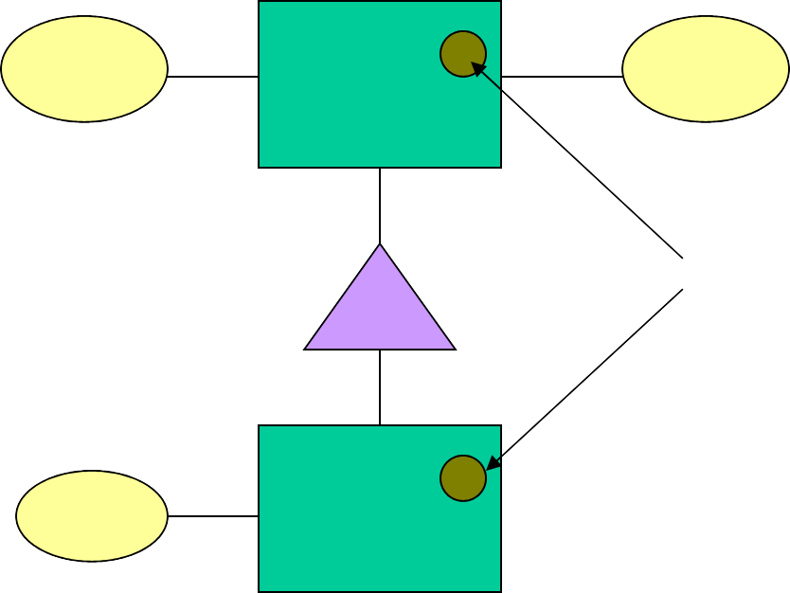
Example: Representatives of Entities
name
Beers
manf
Pete’s Ale
isa
color
Ales

Slide 37
Keys
A key is a set of attributes for one entity set such that no two entities in this set agree on all the attributes of the key.
It is allowed for two entities to agree on some, but not all, of the key attributes.
We must designate指定 a key for every entity set.

Slide 38
Keys in E/R Diagrams
Underline the key attribute(s).
In an Isa hierarchy体系, only the root entity set has a key, and it must serve as the key for all entities in the hierarchy.

Slide 39
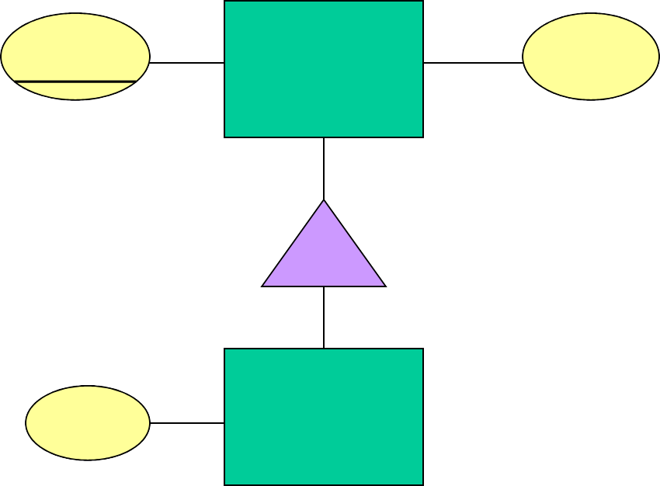
Example: name is Key for Beers
name
Beers
manf
isa
color
Ales

Slide 40
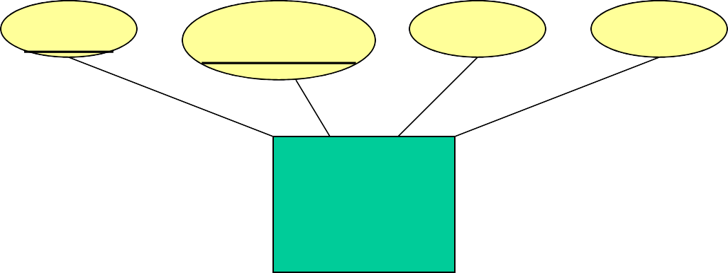
Example: a Multi-attribute Key
dept
number
hours
room
Courses
Note that hours and room could also serve as a key, but we must select only one key.

Slide 41
Weak Entity Sets
Occasionally, entities of an entity set need “help” to identify them uniquely.唯一地
Entity set E is said to be weak if in order to identify entities of E uniquely, we need to follow one or more many- one relationships from E and include the key of the related entities from the connected entity sets.

Slide 42
Example: Weak Entity Set
name is almost a key for football players, but there might be two with the same name.
number is certainly not a key, since players on two teams could have the same number.
But number, together with the team name related to the player by Plays-on should be unique.

Slide 43
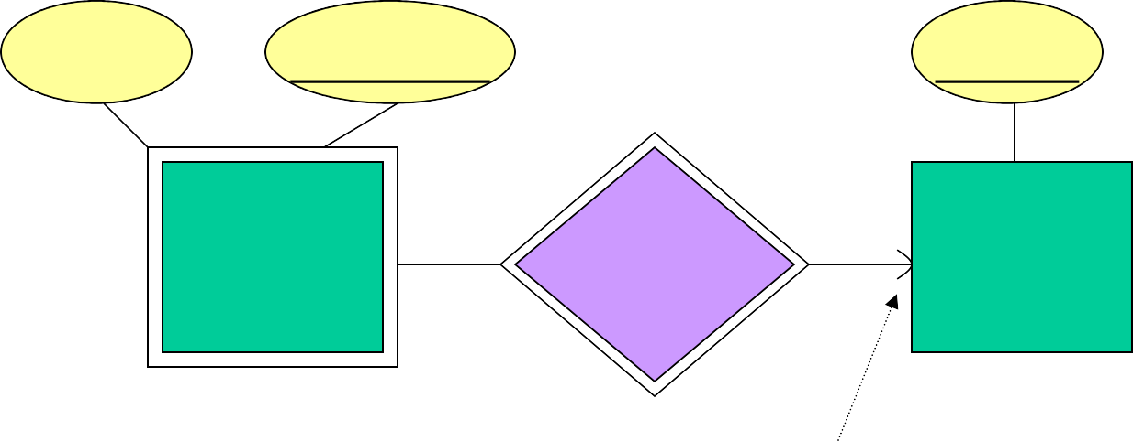
In E/R Diagrams
name
number name
Plays- on
Players
Teams
Note: must be rounded 全面的 because each player needs a team to help with the key.
Double diamond菱 for supporting many-one relationship.
Double rectangle for the weak entity set.

Slide 44
Weak Entity-Set Rules
A weak entity set has one or more many-one relationships to other (supporting) entity sets.
Not every many-one relationship from a weak entity set need be supporting.
But supporting relationships must have a rounded arrow (entity at the “one” end is guaranteed).

Slide 45
Weak Entity-Set Rules – (2)
The key for a weak entity set is its own underlined attributes and the keys for the supporting entity sets.
E.g., (player) number and (team) name is a key for Players in the previous上一个 example.

Slide 46
Design Techniques
Avoid redundancy.冗余
Limit the use of weak entity sets.
Don’t use an entity set when an attribute will do.

Slide 47
Avoiding Redundancy
Redundancy = saying the same thing in two (or more) different ways.
Wastes space and (more importantly) encourages inconsistency.助长矛盾
Two representations of the same fact become inconsistent if we change one and forget to change the other.
Recall anomalies 召回异常due to FD’s.

Slide 48
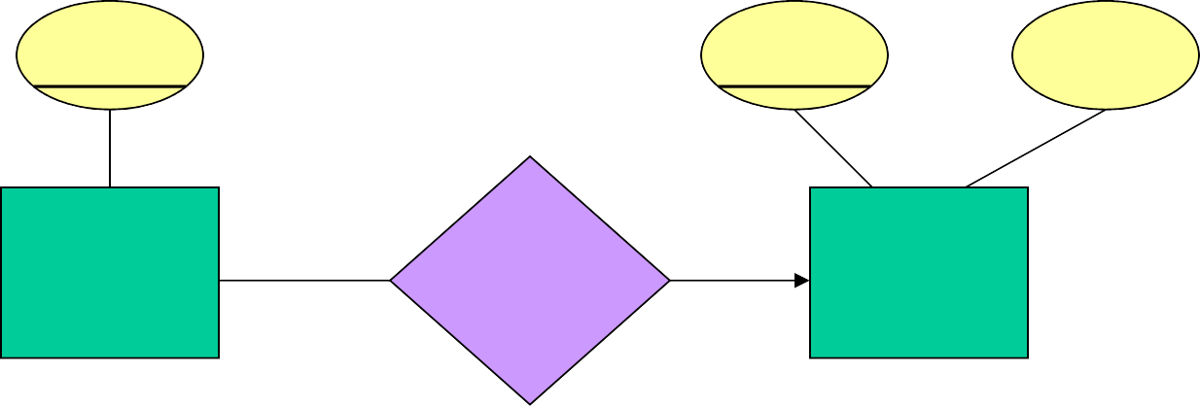
Example: Good
name
name
addr
Beers
ManfBy
Manfs
This design gives the address of each manufacturer exactly once.

Slide 49
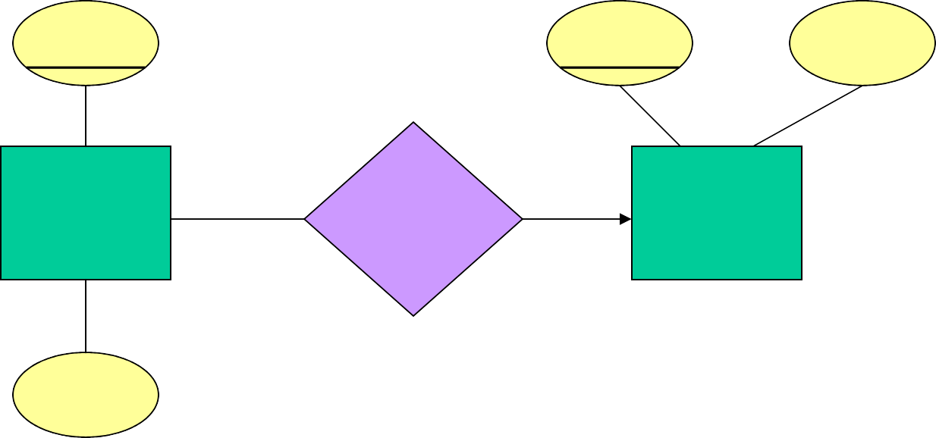
Example: Bad
name
name
addr
Beers
ManfBy
Manfs
manf
This design states the manufacturer of a beer twice: as an attribute and as a related entity.

Slide 50
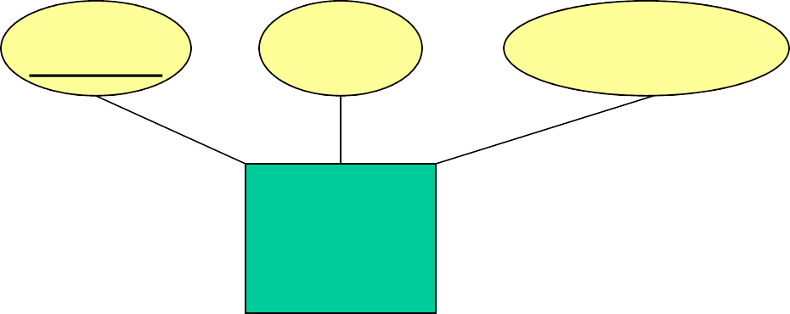
Example: Bad
name
manf manfAddr
Beers
This design repeats the manufacturer’s address once for each beer and loses the address if there are temporarily no beers for a manufacturer.

Slide 51
Entity Sets Versus对比Attributes
An entity set should satisfy at least one of the following conditions:
It is more than the name of something; it has at least one nonkey attribute.
It is the “many” in a many-one or many- many relationship.

Slide 52
Example: Good
name
name
addr
Beers
ManfBy
Manfs
Manfs deserves to be an entity set because of the nonkey attribute addr.
Beers deserves to be an entity set because it is the “many” of the many-one relationship ManfBy.

Slide 53
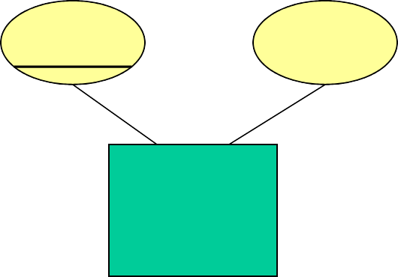
Example: Good
name manf
Beers
There is no need to make the manufacturer an entity set, because we record nothing about manufacturers besides their name.

Slide 54
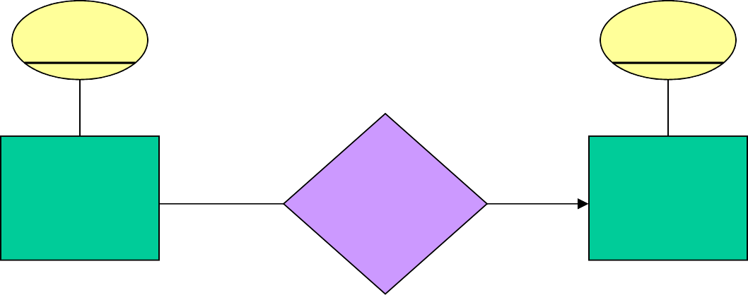
Example: Bad
name
name
Beers
ManfBy
Manfs
Since the manufacturer is nothing but a name, and is not at the “many” end of any relationship, it should not be an entity set.

Slide 55
Don’t Overuse Weak Entity Sets
Beginning database designers often doubt that anything could be a key by itself.
They make all entity sets weak, supported by all other entity sets to which they are linked.
In reality, we usually create unique ID’s for entity sets.
Examples include social-security numbers, automobile VIN’s etc.

Slide 56
When Do We Need Weak Entity Sets?
The usual reason is that there is no global authority capable of creating unique ID’s.
Example: it is unlikely that there could be an agreement to assign unique player numbers across all football teams in the world.

Slide 57
From E/R Diagrams to Relations
Entity set -> relation.
Attributes -> attributes.
Relationships -> relations whose attributes are only:
The keys of the connected entity sets.
Attributes of the relationship itself.

Slide 58
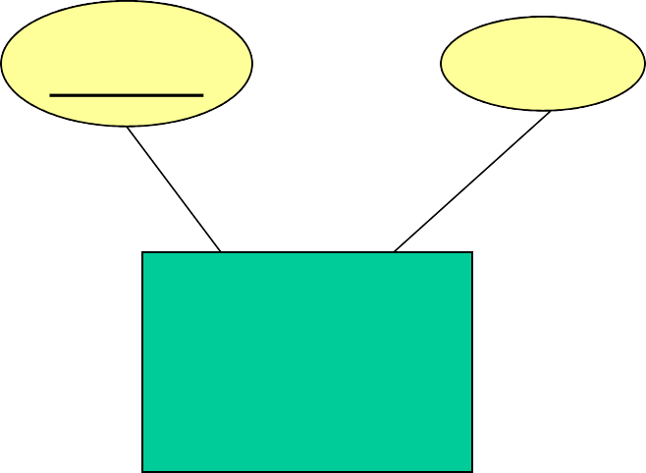
Entity Set -> Relation
name
manf
Beers
Relation: Beers(name, manf)

Slide 59
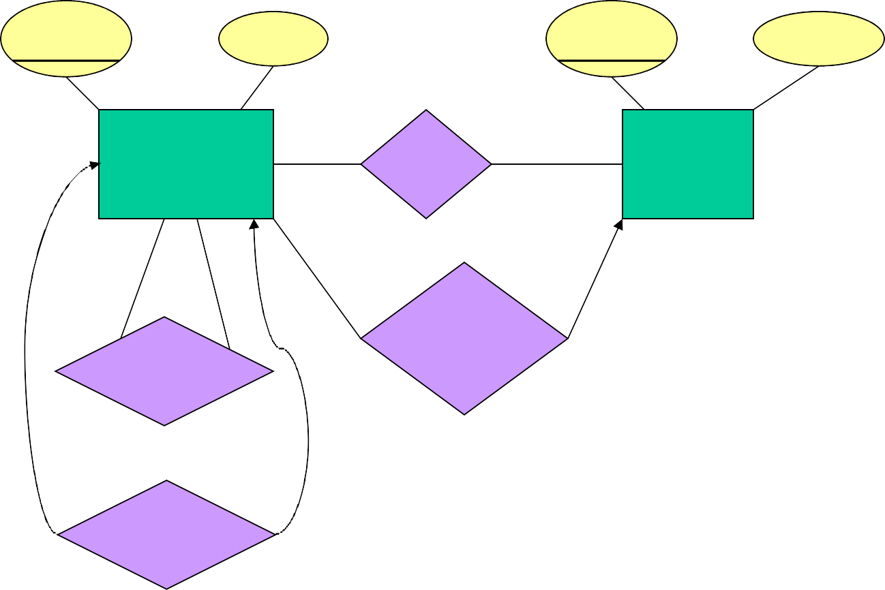
Relationship -> Relation
name addr name manf
Drinkers Likes Beers
husband
1
2
Favorite
Buddies
Likes(drinker, beer) Favorite(drinker, beer)
Buddies(name1, name2) Married(husband, wife)
wife
Married

Slide 60
Combining Relations
OK to combine into one relation:
The relation for an entity-set E
The relations for many-one relationships of which E is the “many.”
Example: Drinkers(name, addr) and Favorite(drinker, beer) combine to make Drinker1(name, addr, favBeer).

Slide 61
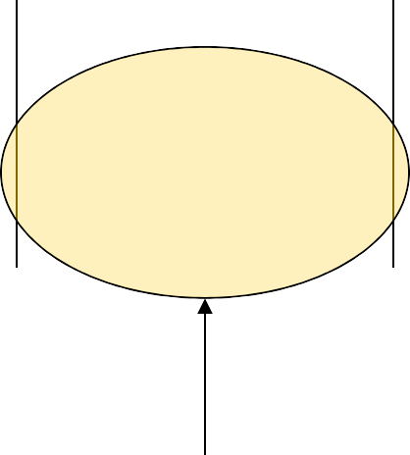
Risk with Many-Many Relationships
Combining Drinkers with Likes would be a mistake. It leads to redundancy, as:
name | addr | beer
Sally | 123 Maple | Bud
Sally | 123 Maple | Miller
Redundancy

Slide 62
Handling Weak Entity Sets
Relation for a weak entity set must include attributes for its complete key (including those belonging to other entity sets), as well as its own, nonkey attributes.
A supporting relationship is redundant and yields no relation (unless it has attributes).

Slide 63
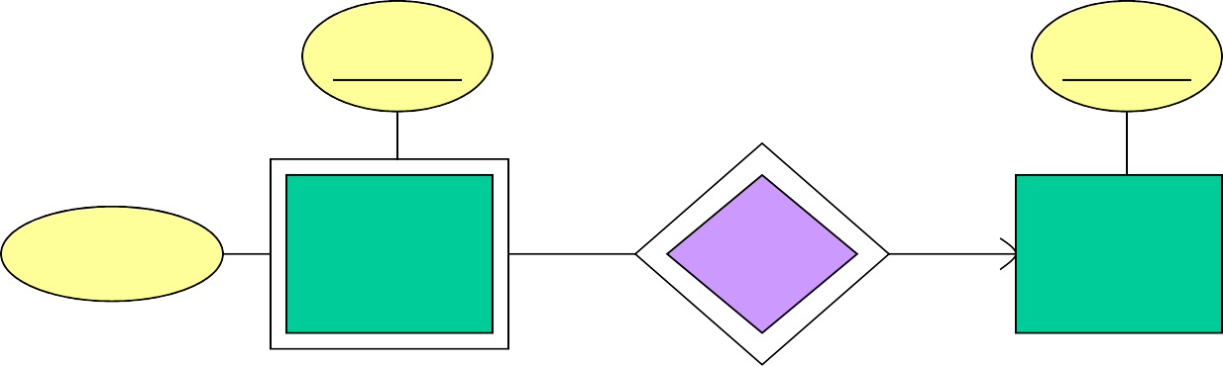
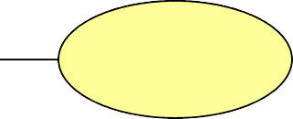
Example: Weak Entity Set -> Relation
name name
billTo
Logins
At
Hosts
location
Hosts(hostName, location) Logins(loginName, hostName, billTo) At(loginName, hostName, hostName2)
At becomes part of Logins
Must be the same

Slide 64
Subclasses: Three Approaches
Object-oriented : One relation per subset子集 of subclasses, with all relevant attributes.
Usenulls : One relation; entities have NULL in attributes that don’t belong to them.
E/Rstyle: One relation for each subclass:
Key attribute(s).
Attributes of that subclass.

Slide 65
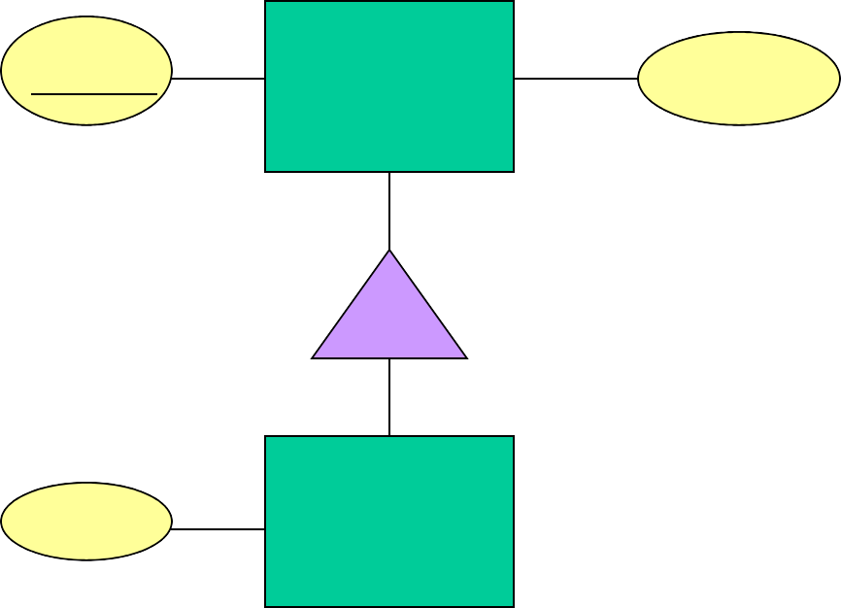
Example: Subclass -> Relations
name
Beers
manf
isa
color
Ales

Slide 66
Object-Oriented
name manf
Bud Anheuser-Busch
Beers
name Summerbrew
manf
color dark
Pete’s
Ales
Good for queries like “find the color of ales made by Pete’s.”

Slide 67
E/R Style
name
manf
Bud Anheuser-Busch Summerbrew Pete’s
Beers
name color
Summerbrew dark
Ales
Good for queries like “find all beers (including ales) made by Pete’s.”

Slide 68
Using Nulls
name Bud
manf Anheuser-Busch
color NULL
Summerbrew
Pete’s
Beers
dark
Saves space unless there are lots
of attributes that are usually NULL.

Slide 69
Homework
设计图书馆管理的数据库，包含以下信 息：图书名称、ISBN（International Standard Book Number，国际标准书号
）、图书类别、书条形码（条形码可以 唯一的对应一本书）、是否已经出借、 学生的信息（学号、姓名、班级、性别 等）、学生已经借阅的图书、借书时间
、还书时间、图书证号码。

Slide 70
需求
其中语义有：每位同学的学号就是图书证号码
，每位同学最多可以借阅5本图书，要登记学 生借阅的具体书（即同时登记ISBN和条形码， 每本书有若干册，ISBN相同，但条形码不同）
，当归还图书时需要把该借阅信息作为历史信 息保存起来，借书期限为一个月（不续借）， 如果学生未能借到书，可以进行预约登记，一 旦有预约的图书归还，数据库将自动使用电子 邮件通知预约学生来借书（假设数据库系统中 有函数mailto(email_address, text)），当借书 完毕，删除预约信息。

